Slide 1
Precision Agriculture
Why do we use it?
What is it?

Slide 2
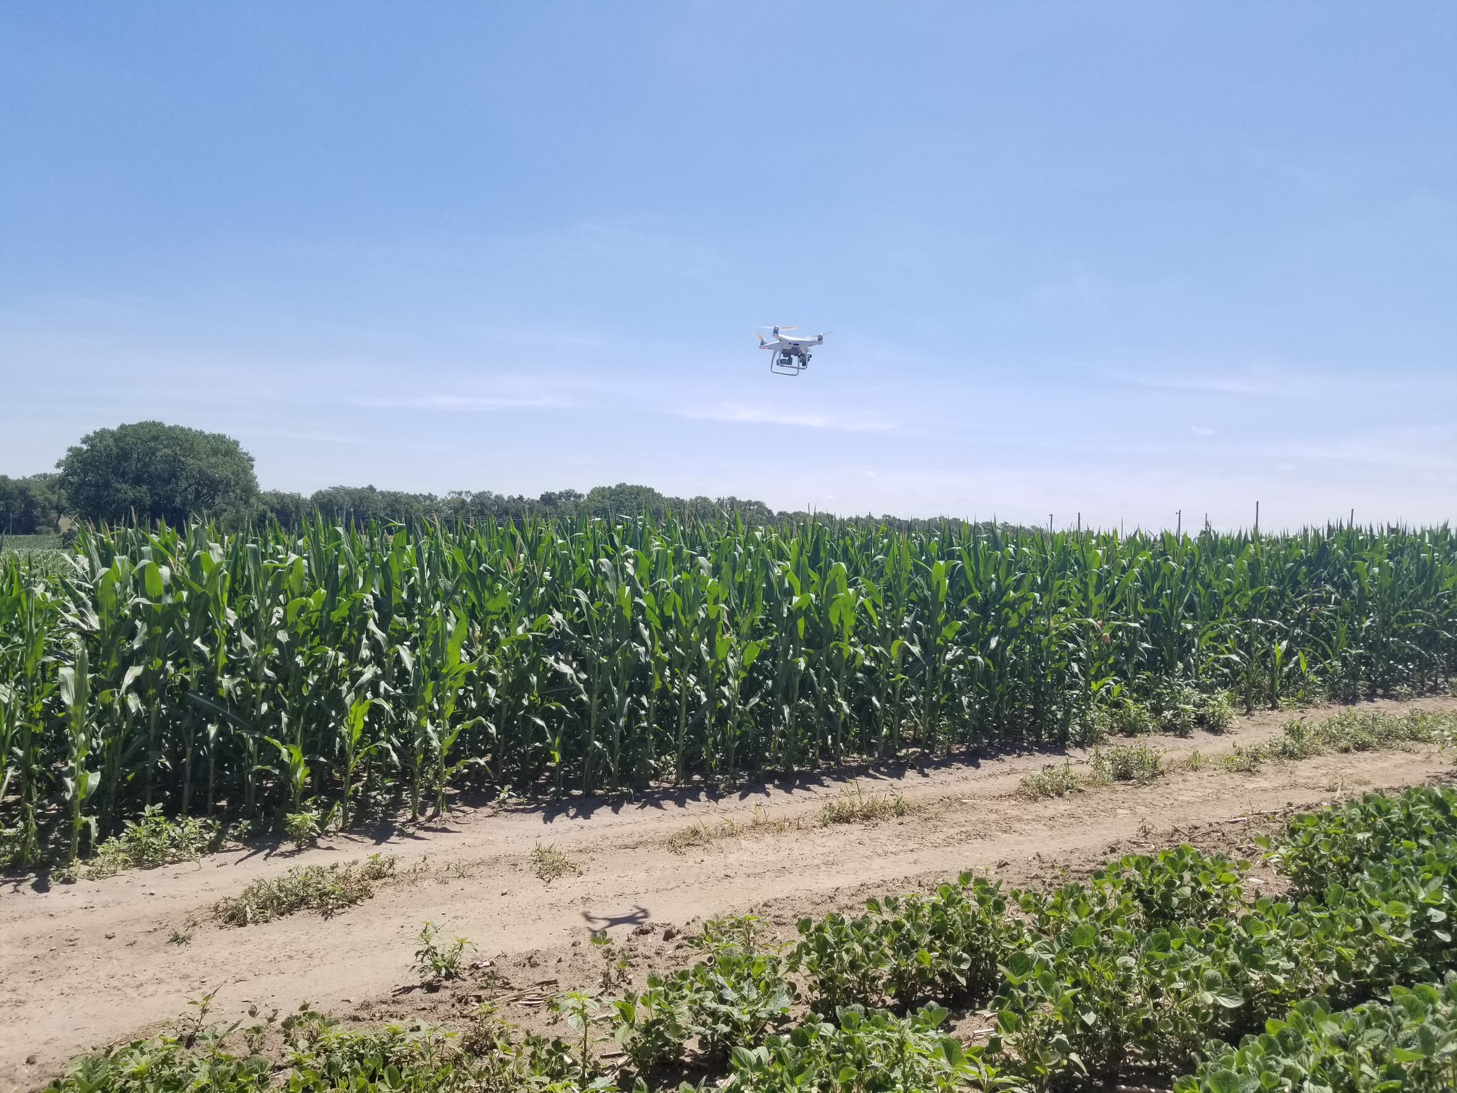
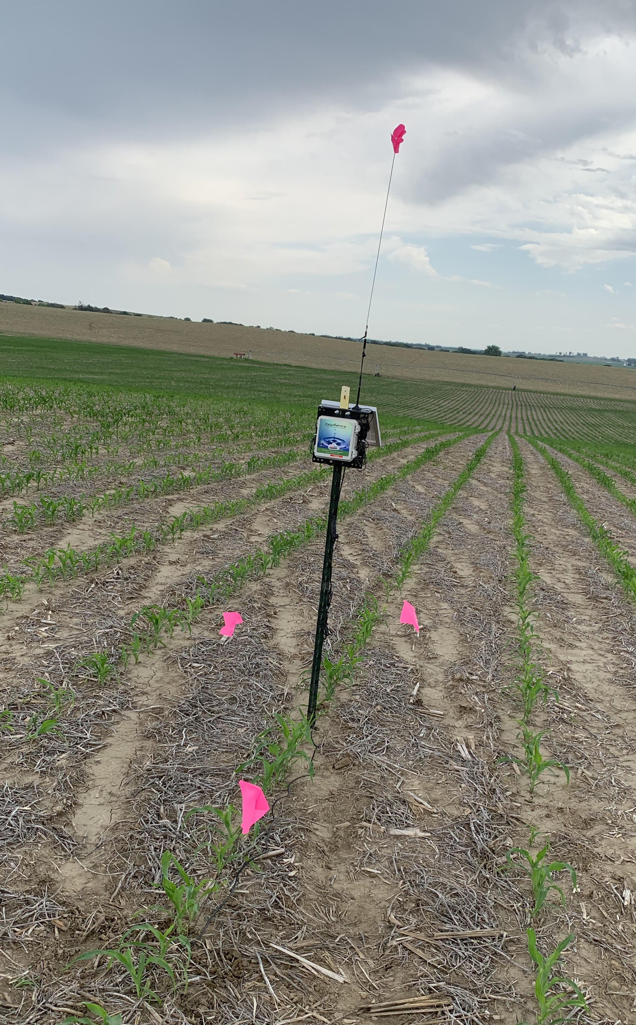
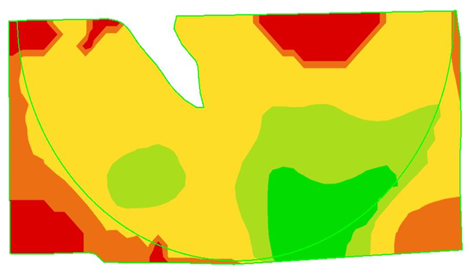
When you hear the words, “precision agriculture”, what do you think of?
Photos courtesy of Courtney Nelson and Rob Thomas
Notes:
Pose this question to your students and see what sort of responses you get. You can use this question for their journal question/question of the day/etc. I have these pictures all staggered on transitions, so the drone photo comes first, then the soil moisture probe, then the “pretty map”. Those are some of the first things that my mind wanders to. You can share your own thoughts with the class. This rolls into the next slide sharing what precision ag really is.

Slide 3
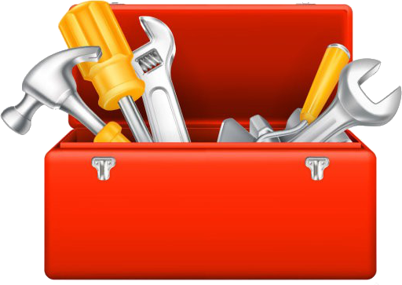
What is Precision Ag?
Is not just the technology
Is a method of farm management
Technology is a tool in our toolbox to enhance our decision making
Optimizing results with less inputs
Stock photos, royalty-free images, graphics, vectors & videos | Adobe Stock
Notes:
While all the things on the last slide are precision ag tools, I want to encourage you to think of precision ag as not just the technology. I challenge you to think about it as a method of farm management. We will dive deeper in further units about the differences in traditional and precision ag practices, but you can explain now that this is us being intentional with our decisions. Saying that we are going to make a specific recipe of a feed ration rather than just throwing in a touch a silage, some hay, maybe some soybean meal today because I’m feeling adventurous. This is also not us going to one area of the field to sample then doing things for the field based on that one spot. This is us working to collect data and going one step further to make sense of the data. Technology is that tool to help us enhance our decision making. “optimizing results with less inputs”. Break down words as needed. I connect optimization to something that they have done or will soon do in math for example. I will have an example where I say, if you are making Chex Mix, you want to have the right mix. Don’t want it too heavy on the Chex, or the M&M’s. Want to find that sweet spot in the middle where you have the mix of sweet and salty. That’s a fun example, and I’d encourage you to share another one if you have one.

Slide 4
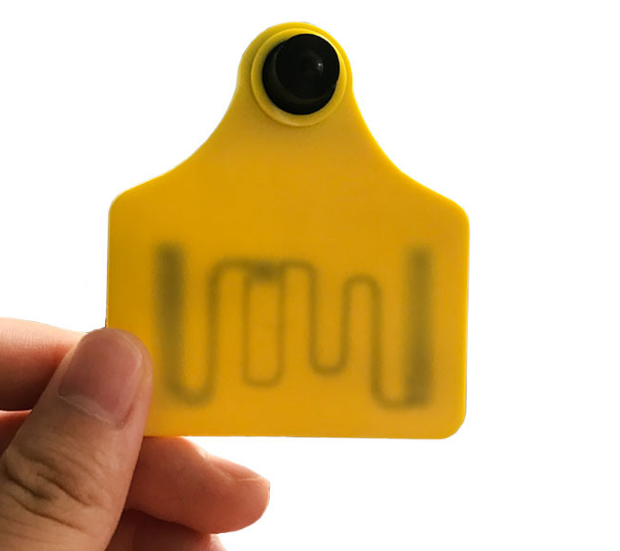
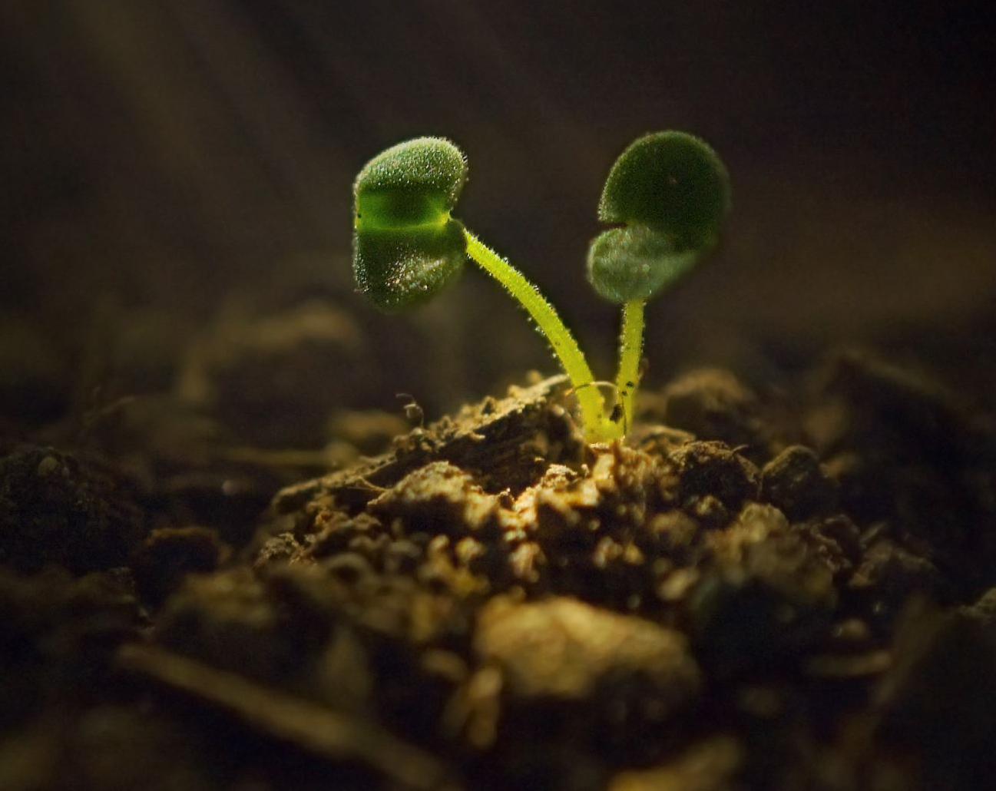
Some Examples
Animal Health:
Planting:
RFID tags showcase
Movement
Feed consumption
Help organize record keeping for the animals as everything is tied to their tag
The right seed
At the right place
At the right time
At the right depth
With the right nutrients and other inputs
Photo courtesy of Microsoft Stock Images and Made in China supply website
Notes:
Management of Fertilizer, Water, Seed/population, and Feed mix/rations. More on this to come. This is to showcase to examples of precision ag to give them a better idea of what this entails. If you have any other examples, please share.

Slide 5
Why does it all matter?
Globally
Feeding 9 billion by 2050
Produce more with less
We’re not gaining more farm ground
Photo courtesy of Microsoft Stock Images
Notes:
It is helpful, as you consider careers, to ponder what problems you enjoy solving. Even when you go to sport events or scroll Tik Tok, you are solving a boredom problem that you are working to fix. You want entertainment, so those are examples of solutions. Let’s jump into the “why” of precision ag before we go too much further. On a global scale, we have to feed 9 billion people by 2050. This will continue to be talked about until 2050, so you will hear about this in college, especially if you go into an agriculture degree. How can we work to accomplish this with urban sprawl? Precision ag may be an option to help us be intentional with the land that we have.
A fun suggestion for you: do the Earth as an Apple demonstration! A link explaining the activity can be found here: Earth as an Apple – Earth Day Activity – Eat Well (canolaeatwell.com)

Slide 6
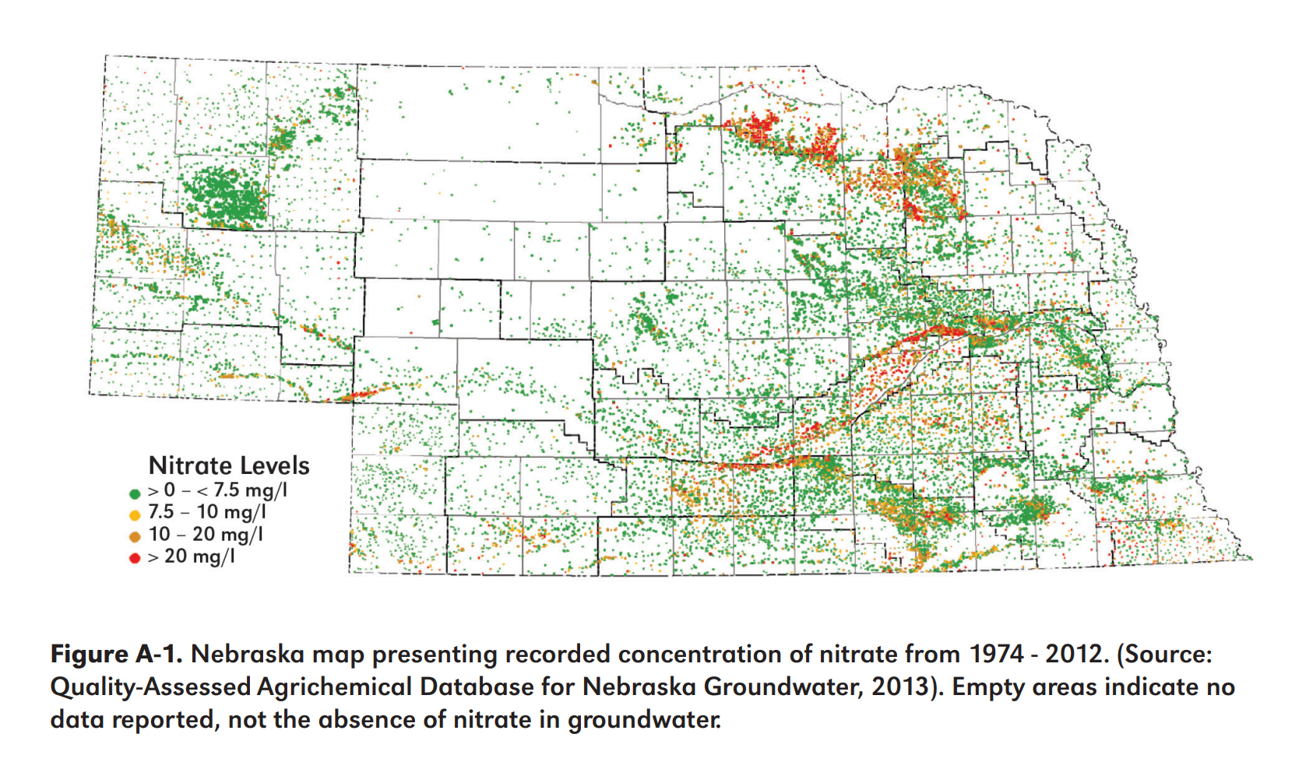
L O C a l
Sustainability, Economic, Human Health
https://extensionpublications.unl.edu/assets/pdf/ec2008.pdf
Notes:
On a local level, nitrate problems. Discuss what is going on in this graph. Orange and red dots are problems, as the safe level for nitrate concentration in our water is less than 10 ppm or mg/L. Have them find where your school is on the map. Also see if they notice the trend that high nitrates follow the rivers in the state and land in areas near our riverbeds. This can trickle into conversations about items such as: load control, drought, Republican River debacle, conservation. These nitrate issues can ultimately cause health issues.
One example of a health issue is blue baby syndrome. This predominantly affects infants and elderly folks, but high nitrate concentrations can attack the oxygen in your blood. By blocking that oxygen, it makes it more difficult to breathe, and, in extreme cases, will cause their skin to physically turn blue since they can’t breathe properly. Health experts are also beginning to contribute nitrate levels to higher levels of cancer rates. In Platte County with families that live along the Loup River, they are beginning to see trends of colon cancer. They are starting to attribute this to the water quality in their region. Take-home message: water testing at home and being intentional with lawn and field fertilizer application is important.
Another “why” for farmers when if comes to wanting to adopt precision ag is profitability: help farmers bring more children back into the operation, or get them back to the operation sooner. Even allow the farmer in general to make a living.

Slide 7
How does Precision Ag Help?
Technology
Data/Information
Interpretation/Decision-making
Technology reveals Variability
Differences
Managers interpret information
Managers make intentional management decisions for specific areas of the field or herd
Put fewer inputs in less productive areas of the field and vice versa
Photo courtesy of Microsoft Stock Images
Notes:
How does precision ag help solve these issues and more?
There are three main components to precision ag: Information, technology, and management. They all three rely on one another, like a three-legged stool. Precision ag technologies help reveal variability in your field, herd, pasture, landscape, etc. We can then interpret the information we are receiving from these tools to help us make more intentional decisions for the specific areas of the field or herd that we see. This can involve putting more inputs in an area of field that can produce better than areas that consistently get flooded out as an example.

Slide 8
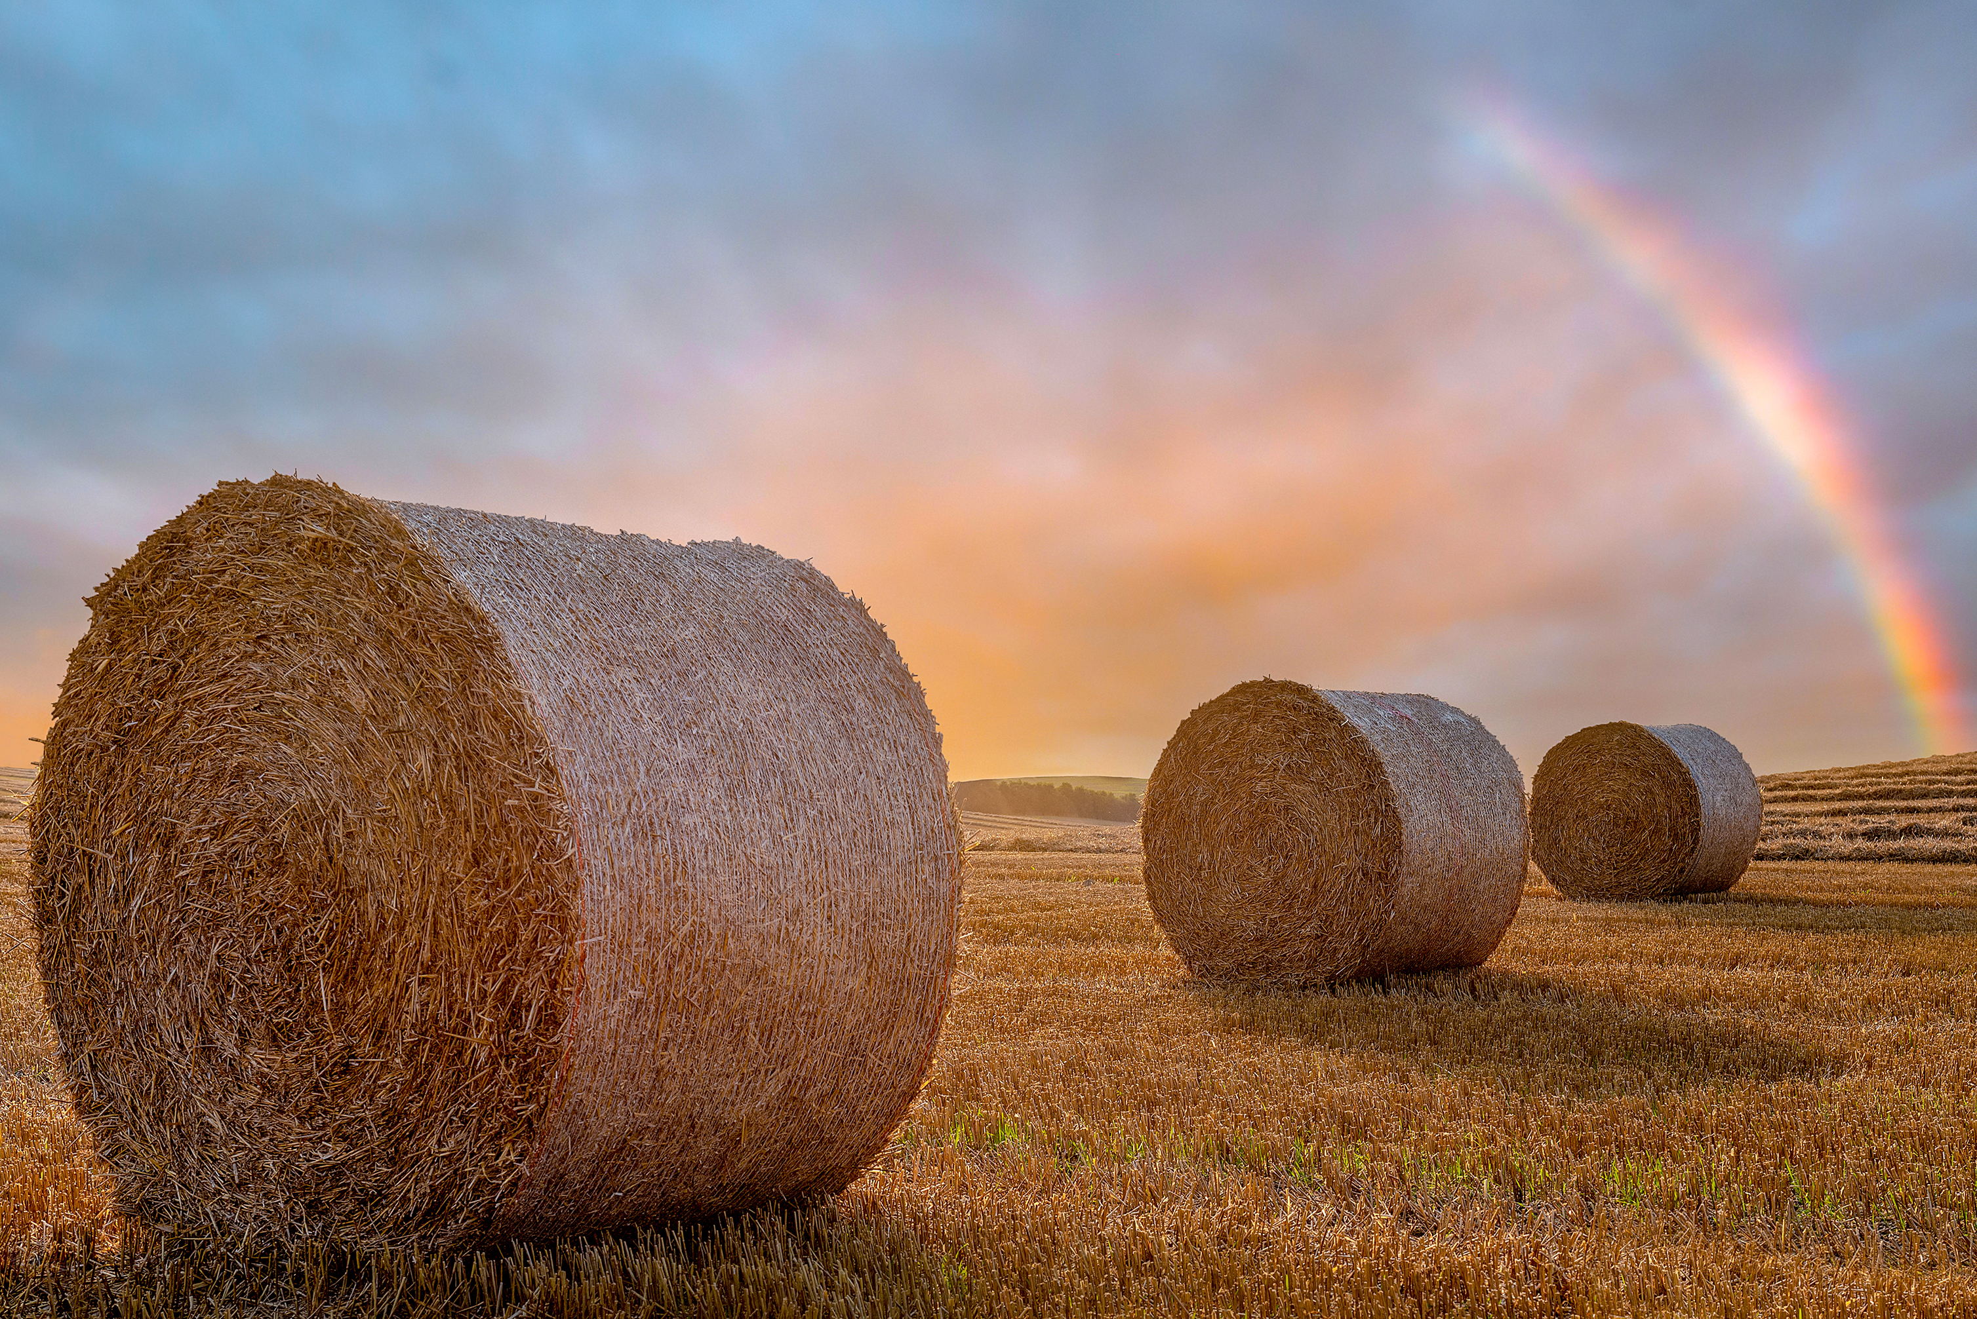
Activity!
Soil Variability
Grid Sampling
Represent different soil types in one field
Photo courtesy of Microsoft Stock Images
Notes:
We have an activity developed that you can get up and do with your students now! It will take fifteen-twenty minutes, depending how thorough the students are with coloring their map in. The directions should be available in the folder where you retrieved this powerpoint.
Take Home Message from Activity:
Variability is everywhere. Even across a field. We need to learn how to manage each component.
Here are some extra activities that you could do to build on this:
Look up a field on Web Soil Survey and allow them to see how different soils need different inputs.
Get samples of sand, silt, and clay and dump water on each of them to also showcase these differences.

Slide 9
Yield Map
Dark Green—Optimum
Light Green—2nd Highest
Yellow—3rd Highest
Gold—4th Highest
Orange—5th Highest
Red—Lowest
Photo courtesy of Northeast Community College
Notes:
Let’s look at two maps showing different characteristics of the same field and begin to understand how factors impact one another. Explain that this is an example of a yield map. We have a simple legend on the left to help guide you. On the next slide we have a corresponding subsoil moisture map.

Slide 10
Corresponding Subsoil moisture Map
Dark Blue—highest amount of moisture in soil layer
Medium Blue—2nd Best
Light Blue—3rd Best
Dark Green—4th Best
Med Green—5th Best
Light Green—6th Best
Yellow—7th Best
Light Orange—8th Best
Dark Orange—9th Best
Red—Poorest
Photo courtesy of Northeast Community College
Notes:
On this slide, we have a subsoil moisture quantity map. I want you to notice and understand how to look at two different aspects of the same field and compare the too. That is actually what we are going to do right now (hit next slide).

Slide 11
Analyze the Maps (Mingle/Pair/Share)
Compare the soil moisture and yield maps
What similarities are there?
What could account for these similarities?
What differences are there?
What could account for those differences?
Side by side comparison on the next slide!

Slide 12
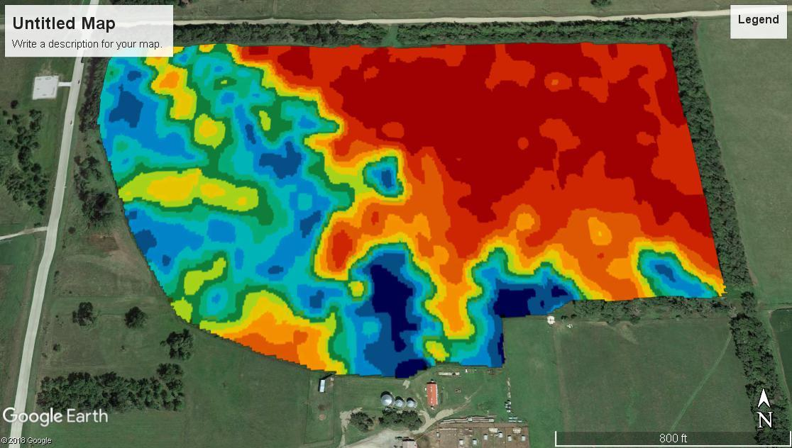
Compare & Contrast
Subsoil moisture map: Blue is the best soil and red is the worst
What accounts for these similarities and differences?
Yield map: Dark green is the best and red is the worst
Notes:
You will notice in this simple example that the trend appears to be that the yields are better in the areas where there is more amounts of subsoil moisture. This makes sense. Also, there is a slight slope to this field and the east end of the field is the slope of the hill. That area is also sandier, so it won’t hold as much water. Of course, these are details that you can’t see in these maps, but these are the kind of things you can begin to make assumptions about by seeing these pieces of data.

Slide 13
Misconceptions & Myth
DEBUNKED!
Adopting precision ag is complex. There are some myths among operators.
Equipment of nearly any age can be equipped with precision ag equipment.
-Here are three sample vendors that work to set up older equipment with tech:
Precision Planting
Ag Leader
Raven Industries
Most precision ag companies charge on a per acre basis. This means you can see benefits on an operation of 100 acres or 1000 acres.
“I have to buy all new equipment to implement precision ag.”
This is not all or nothing! You can choose how many acres/fields you want to test a technology with and change season to season.
“I have to implement a technology across the entire operation to see a benefit.”
“I have to be a big operation to use precision agriculture.”
Notes:
Before we dive deep into future lessons, I want to address some common phrases that are heard as roadblocks to adoption of precision ag technology. Let’s pull them up here then let’s discuss the truth around some of these misconceptions.
I always clarify my first explanation to say that besides antique tractors, most of the stuff that we use today can be equipped with equipment.
For the middle myth explanation, you can make a connection by saying this isn’t poker. You don’t have to go all in and potentially lose everything. Because! As the next text box explain, most companies charge on a per acre basic. This means you can see benefits of an operation of 100 acres or 1000 acres.

Slide 14
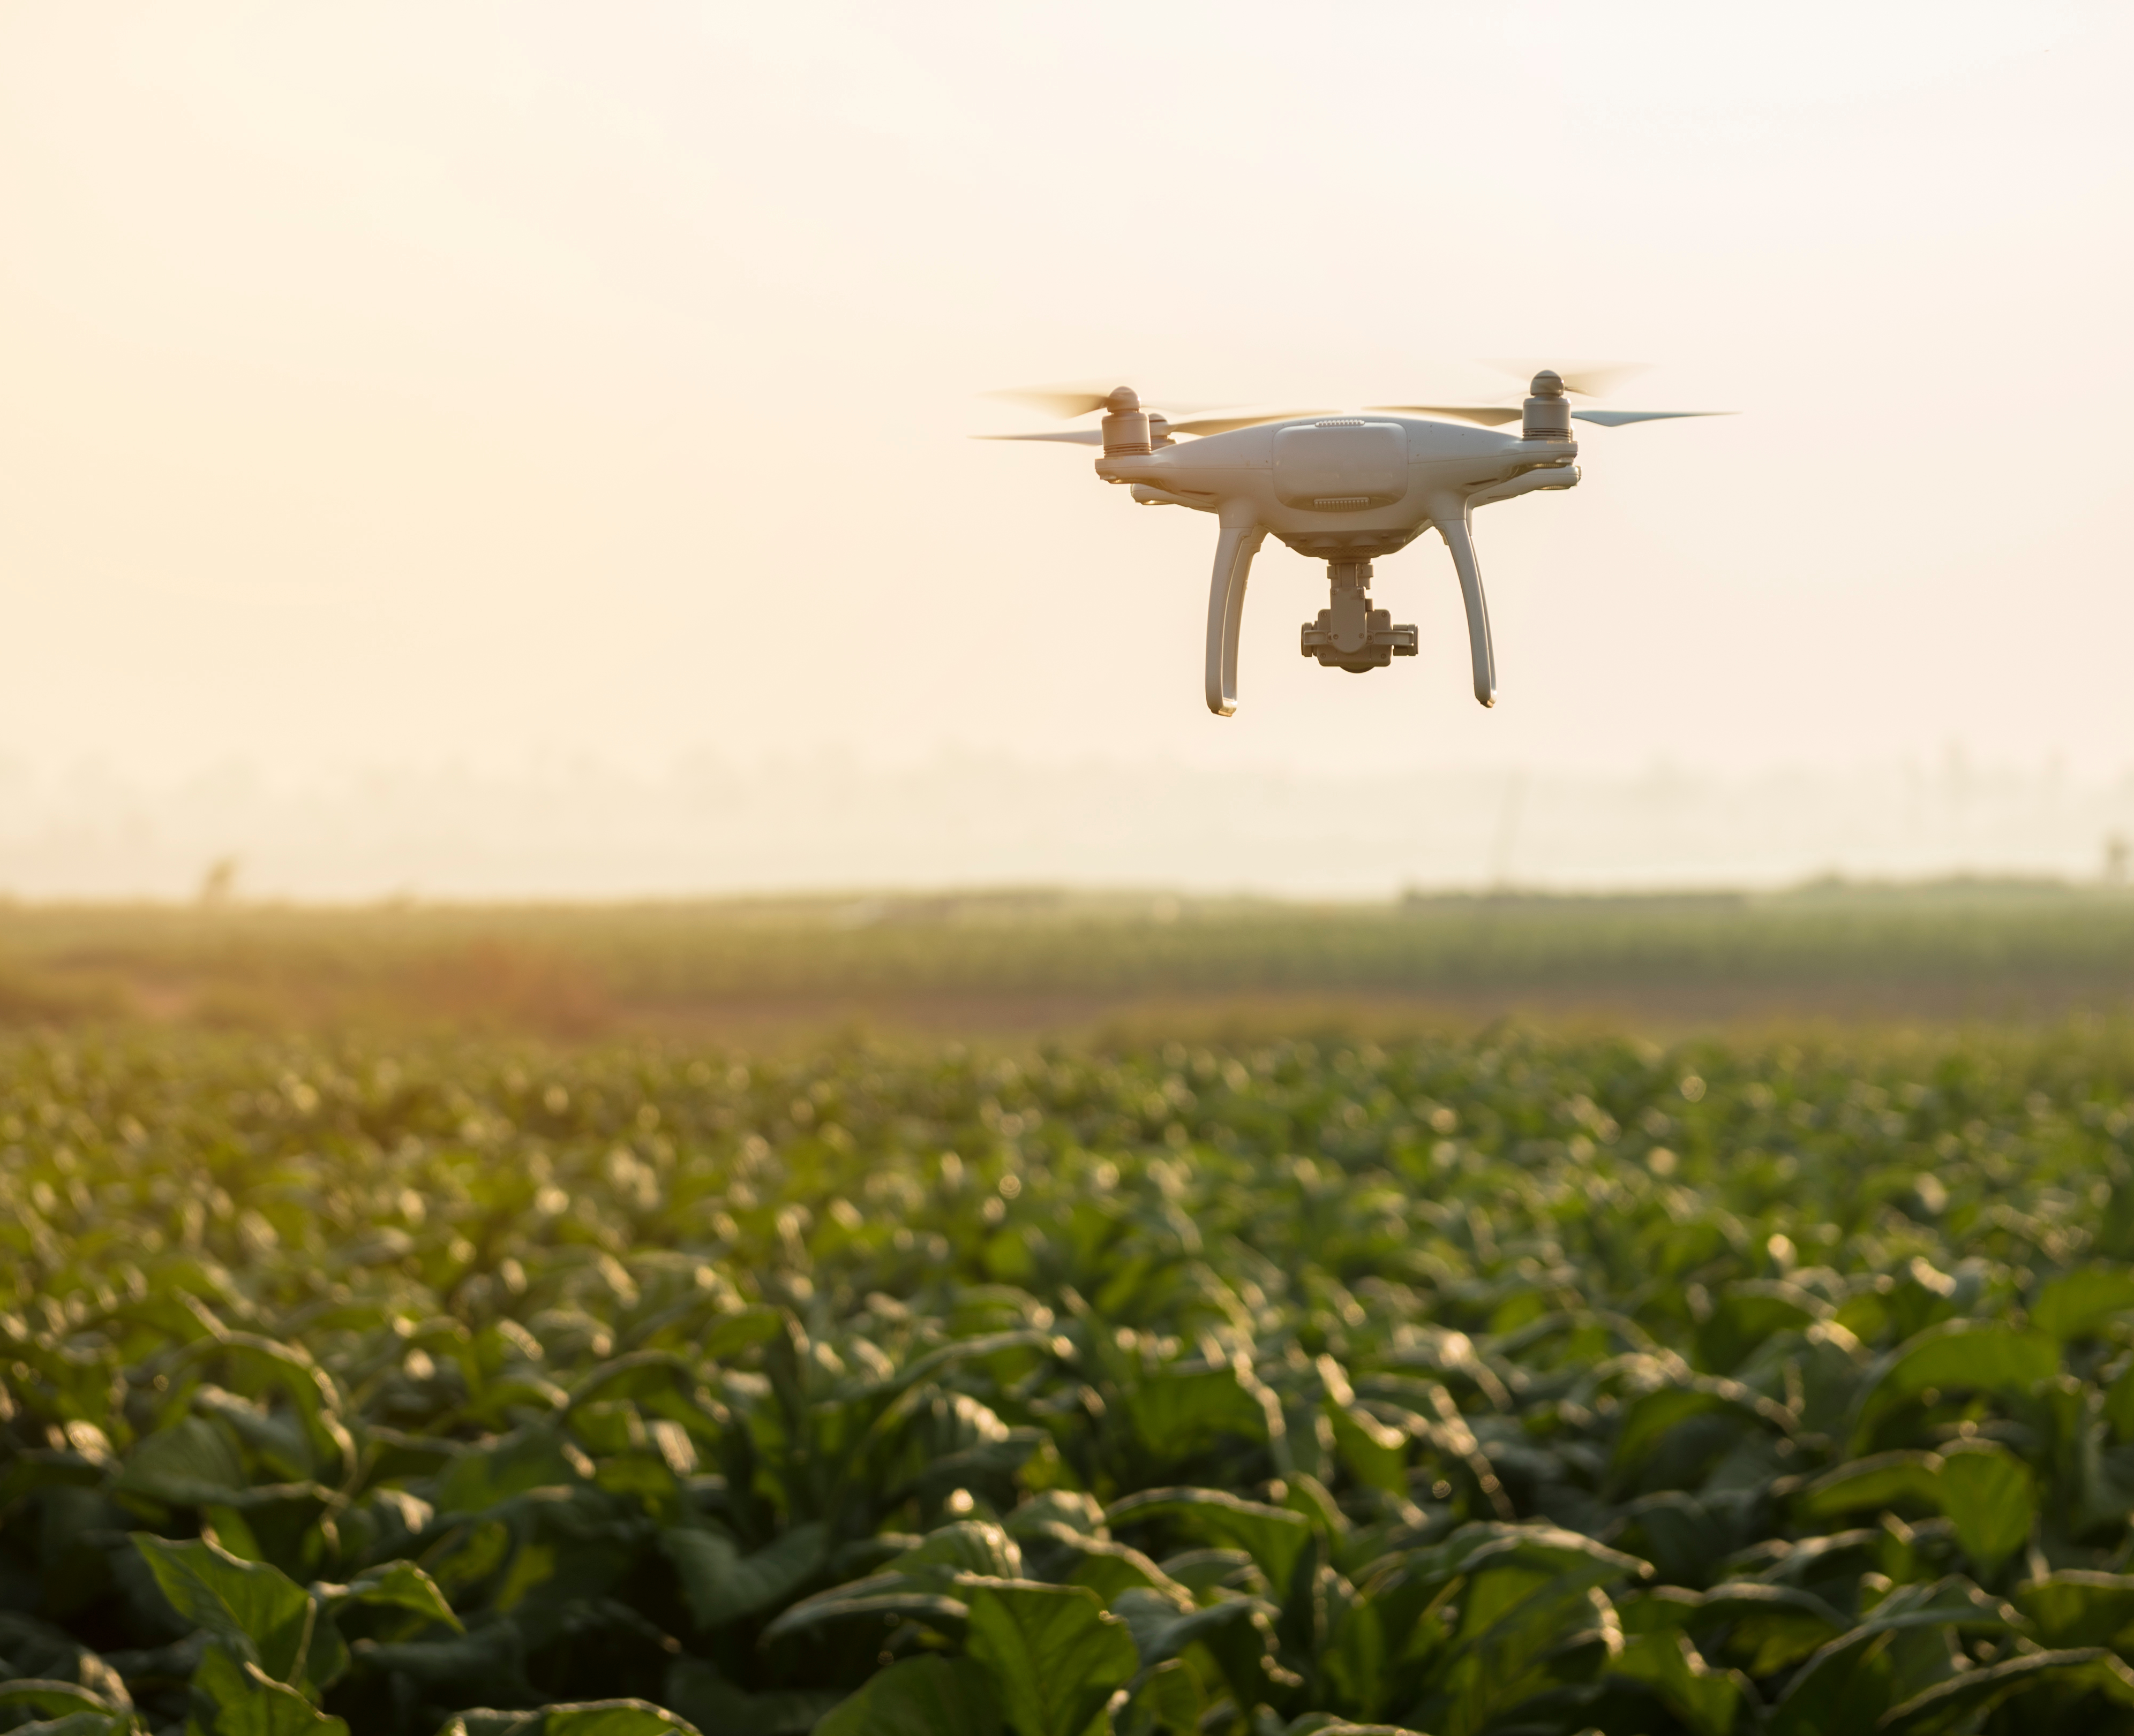
Some Challenges
Full implementation takes time
Steep learning curve to analyze the data
Data analysis is a time-consuming project
Initial investment may be high
What other challenges can you think of?
Notes:
With every new development or technology, adoption takes time. It can be frustrating, daunting, and overwhelming, at times. Here are some challenges I have thought of:
Full adoption takes several years to gather the data to make truly informed decisions. For example, if a farmer begins to adopt no-till farming practices in their operation, it can take about ten years to get results that you are really looking for. You have to be patient with waiting for the results. Similar to working out and getting fit. It will take time.
There is a steep learning curve to learning the data. There can be a lot of trainings on the wide array of features that different companies can offer.
Data analysis is a time-consuming project. Due to the amount of data that you can collect, it can take a while to sift through all of it and see what is helpful.
Some of the initial investments can be very costly as you start out adopting new tools. The operation may not have cash on hand to do this.
What other challenges can you think of?

Slide 15
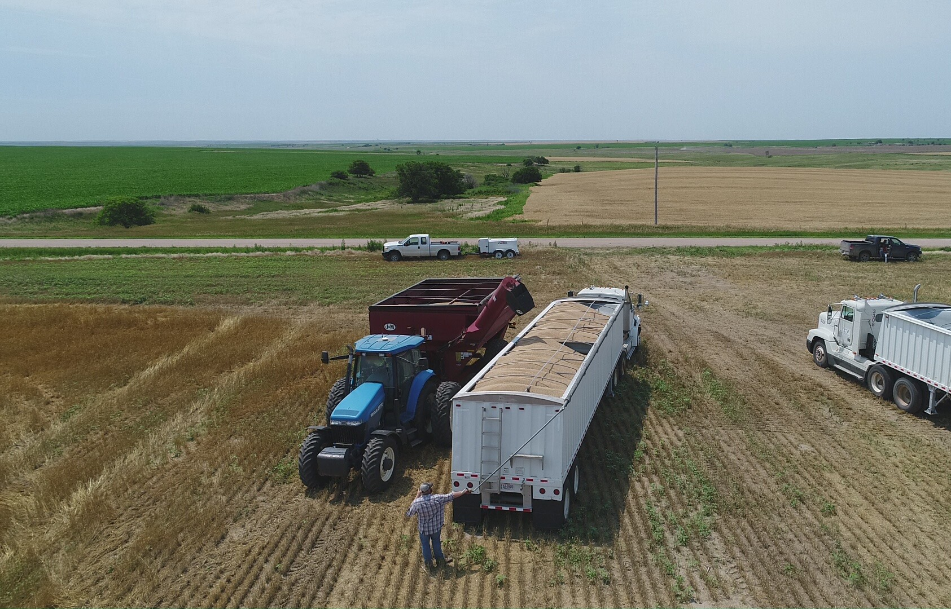
Your Return on Investment
Get more information about the operation
Make better-informed decisions
Provides opportunities for better resource management
Could reduce waste and increase profitability
Can help us solve the nitrate and food scarcity problems we discussed in the opening
What other benefits can you think of?
Photo courtesy of Courtney Nelson
Notes:
This information can come in a lot of different forms. Examples:
It can reveal that our plants need water before our human eyes can tell.
It can pick up on sick animals before we can notice.
Can help us check on our herds in a large pasture.
Can save the soil from saturation of water or nutrients that the area doesn’t need.
It can help us save money on inputs such as seed, water, chemical, time, etc.

Slide 16
Recap
Precision ag is a method of farm management
Helps us identify variability in the field
Intentional decisions
Technology is the tool used to enhance our decision making
Not meant to replace the farmer, agronomist, nutritionist, etc..
We are making deliberate decisions on our farms
This can impact county, state, nation, or world

Slide 17
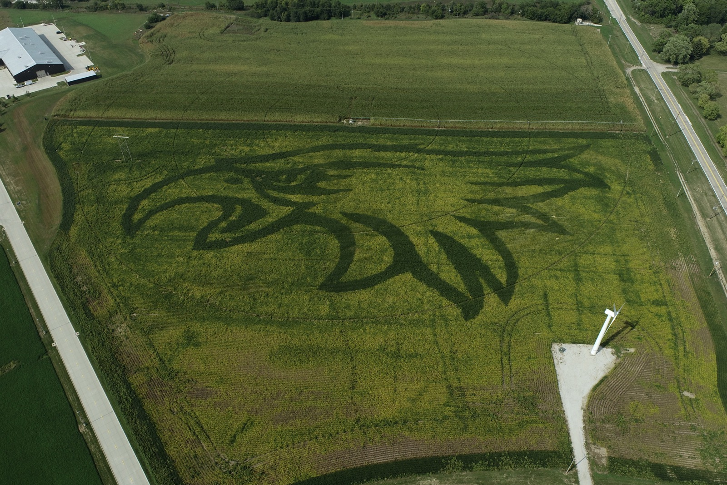
THANK YOU
Courtney Nelson
Precision Agriculture Trainer
cnelson10@northeast.edu
Photos courtesy of Craig Chandler and Rob Thomas
Notes:
The hawk was done utilizing different prescriptions with different relative maturities.

Slide 18
Acknowledgments
This material is based upon work supported by the National Science Foundation under Grant No. 1700680. Any opinions, findings, conclusions, or recommendations expressed in this material are those of the author(s) and do not necessarily reflect the views of the National Science Foundation.
The CHS Foundation, funded by charitable gifts from CHS Inc., is focused on developing a new generation of agriculture leaders for life-long success. Together, with our partners, we are igniting innovation and driving excellence in agricultural education, cultivating high-impact programs for rural youth and accelerating potential for careers in agriculture. Learn more at chsfoundation.org.

